Slide 1
Naïve Bayes

Slide 2
Agenda
Probability Review
Bayes Theorem
Naïve Bayes
Text Analysis
Code Walkthrough

Slide 3

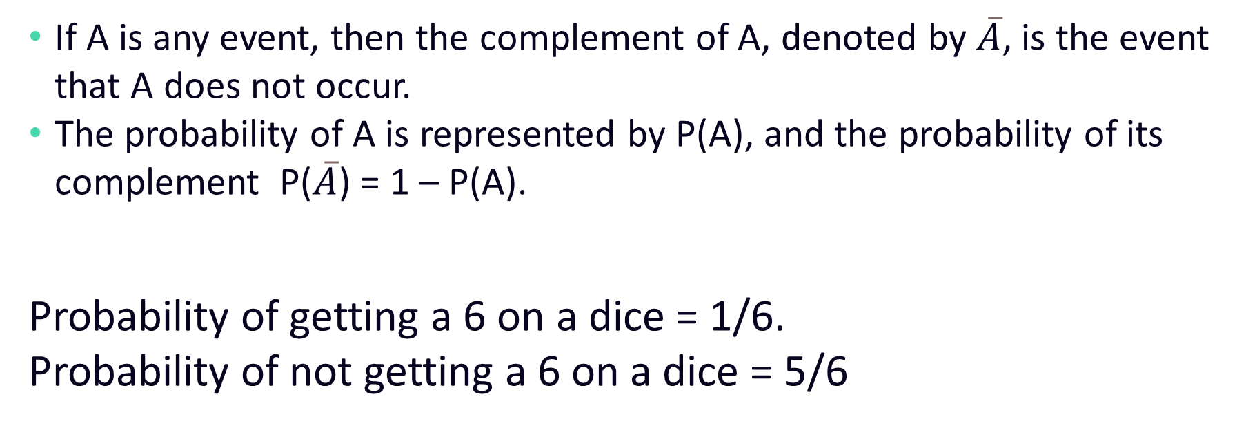
Probability Review
If A is any event, then the complement of A, denoted by $\overline{A}$, is the event that A does not occur.
The probability of A is represented by P(A), and the probability of its complement P($\overline{A}$) = 1 – P(A).
Probability of getting a 6 on a dice = 1/6.
Probability of not getting a 6 on a dice = 5/6

Slide 4
Conditional Probability
Number
1 | Odd
2 | Even
3 | Odd
4 | Even
5 | Odd
6 | Even
Now let’s find out the probability of 6 occurring provided we know that it is already an even number.
P(6|Even) = 1/3
For events A and B with probabilities P(A) and P(B)
P(A|B) = P(A and B) / P(B)

Slide 5
Independent Events
Two events are said to be independent events when the occurrence of one event does not affect the other.
P(A and B) = P(A) P(B)
P(A|B) = P(A)
Notes:
In previous example two events A and B are not independent. Because if I tell you if it is Even or Odd, that changes the prob of 1-6.
Occurrence of one doesn’t affect the other.
To give you an example of independent events, consider rolling two dices and getting 1 on each. Which will be 1/6*1/6 = 1/36.
P(A|B) = P(A & B)/P(B) => P(A)

Slide 6
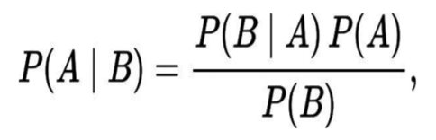
Bayes’ Theorem
The theorem can be stated mathematically as follow:​
P(A) and P(B) are the probabilities of observing A and B without regard to each other. Also known as Prior Probability. ​
P(A | B), a conditional (Posterior) probability, is the probability of observing event A given that B is true.​
P(B | A) is the conditional (Posterior)probability of observing event B given that A is true. ​

Slide 7
Bayes’ Theorem Example
A disease occurs in 0.5% of the population
A diagnostic test gives a positive result in:
99% of people with the disease
5% of people without the disease (false positive)
A person receives a positive result
What is the probability of them having the disease, given a positive result?

Slide 8
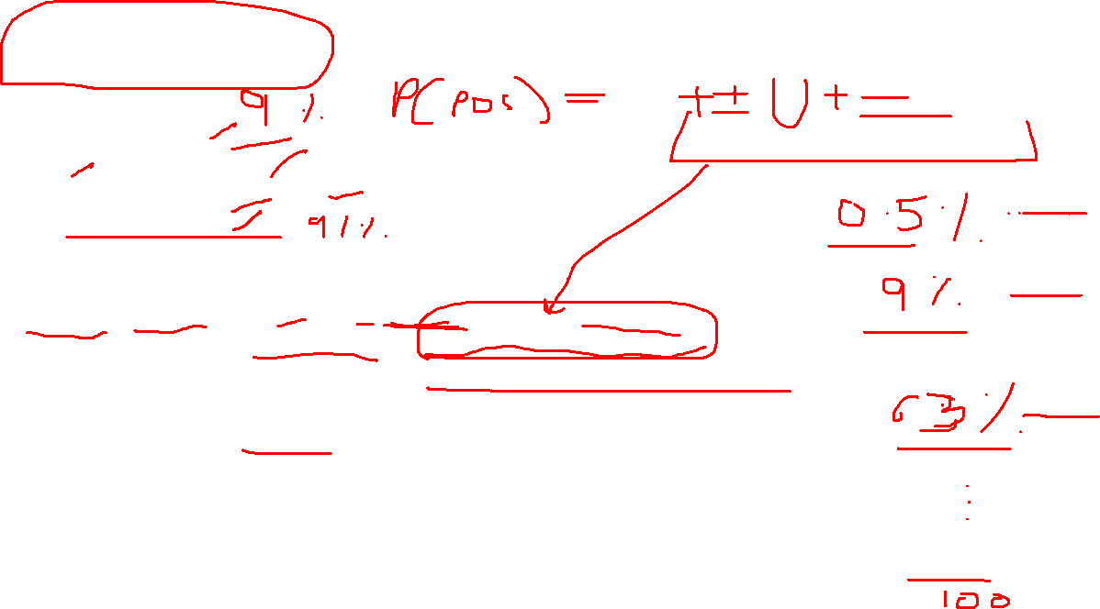
Bayes’ Theorem Example
P(Disease) = 0.005
P(Positive | Disease) = 0.99
P(Positive | No Disease) = 0.05
P(No Disease) = 0.995
P(Disease | Positive) = ?
P(Disease | Positive) = P(Pos and D)/P(Pos)
= P(Pos | D) * P(D) / (P(Pos and D) + P(Pos and ND))
= P(Pos | D) * P(D) / (P(Pos | D) * P(D) + P(Pos | ND) * P(ND) )
= 0.99 * 0.005 / (0.99*0.005 + 0.05 * 0.995)
= 0.09
In other words, if the report is positive, the chances of actually having the disease is 0.09 (9%)

Slide 9
Naïve Bayes Classifier
Probabilistic model based on Bayes’ theorem.
It estimates conditional probability which is the probability that something will happen, given that something else has already occurred.
It assumes that the features in the dataset are mutually independent. Hence it is called “Naïve”.
This assumption is often violated in the real world, but the classifier still performs very well.

Slide 10

Naïve Bayes Example
OUTLOOK | TEMPERATURE | HUMIDITY | WINDY | FLIGHT ON TIME
Rainy | Hot | High | FALSE | No
Rainy | Hot | High | TRUE | Yes
Overcast | Hot | High | FALSE | Yes
Sunny | Mild | High | FALSE | No
Sunny | Cool | Normal | FALSE | Yes
Sunny | Cool | Normal | TRUE | No
Overcast | Cool | Normal | TRUE | Yes
Rainy | Mild | High | FALSE | No
Rainy | Cool | Normal | FALSE | Yes
Sunny | Mild | Normal | FALSE | Yes
Rainy | Mild | Normal | TRUE | Yes
Overcast | Mild | High | TRUE | Yes
Overcast | Hot | Normal | FALSE | Yes
Sunny | Mild | High | TRUE | No

Slide 11

Naïve Bayes Example
Outlook | Yes | No | P(O|Yes) | P(O|No)
Sunny | 2 | 3 | 2/9 | 3/5
Overcast | 4 | 0 | 4/9 | 0
Rainy | 3 | 2 | 3/9 | 2/5
Total | 9 | 5 | 1 | 1
Temperature | Yes | No | P(T|Yes) | P(T|No)
Hot | 2 | 2 | 2/9 | 2/5
Mild | 4 | 2 | 4/9 | 2/5
Cool | 3 | 1 | 3/9 | 1/5
Total | 9 | 5 | 1 | 1
Humidity | Yes | No | P(H|Yes) | P(H|No)
High | 3 | 4 | 3/9 | 4/5
Normal | 6 | 1 | 6/9 | 1/5
Total | 9 | 5 | 1 | 1
Wind | Yes | No | P(W|Yes) | P(W|No)
False | 6 | 2 | 6/9 | 2/5
True | 2 | 3 | 2/9 | 3/5
Total | 9 | 5 | 1 | 1

Slide 12
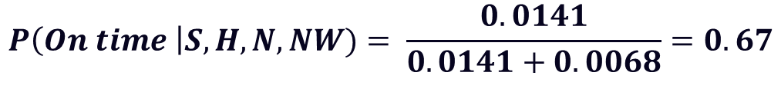
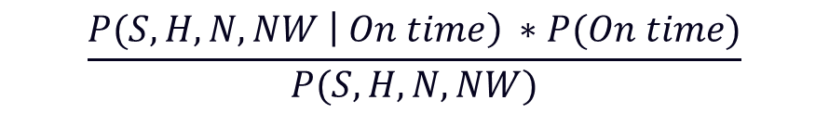


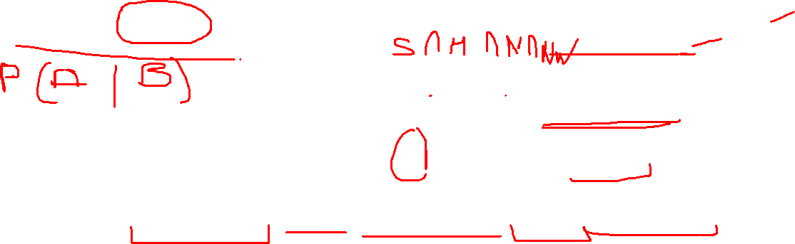
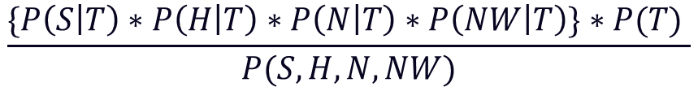
Naïve Bayes Example
Sunny | Hot | Normal | False
$$\frac{P(S,H, N, NW \left| On time\right) ∗P(On time)}{P(S,H, N, NW)}$$
$$P\left(On time \right|S,H, N, NW)$$
=
$$\frac{\{P\left(S | T\right)∗P\left(H | T\right)∗P\left(N | T\right)∗P\left(NW | T\right)\}∗P(T) }{P(S, H, N, NW)}$$
$$P\left(S | T\right)∗P\left(H | T\right)∗P\left(N | T\right)∗P\left(NW | T\right)∗P(T)$$
=
$$\frac{2}{9}∗\frac{2}{9}∗\frac{6}{9}∗\frac{6}{9} ∗\frac{9}{14} =0.0141$$
$$P\left(S, H, N, NW\right)=P\left(S, H, N, NW \right| T) ∗P\left(T\right)+P\left(S , H, N, NW \right| NT)∗P(NT)=0.0141 ∗0.0068$$
$$P\left(On time \right|S,H, N, NW)= \frac{0.0141}{0.0141+0.0068}=0.67$$

Slide 13
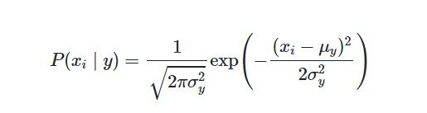
Gaussian Naïve Bayes
It is used when we have continuous independent data.
It uses probability distribution function to calculate the probabilities.

Slide 14
Pros and Cons
Simple, fast and effective.
Perform well with noisy and missing data.
Requires few examples to train.
Easy to obtain estimated probability.
It relies on the assumption of independent features which is mostly incorrect.
Not ideal for continuous data. We can use Gaussian Naïve Bayes classifier to solve this problem.
Incorrect predictions if rare events are not captured in the training set but appears in the test set.

Slide 15
Text Analysis
Token | Doc 1 | Doc 2 | Doc 3
he​ | 1​ | 0​ | 0​
suddenly​ | 1​ | 0​ | 0​
became​ | 1​ | 0​ | 0​
very​ | 1​ | 0​ | 0​
happy​ | 1​ | 1​ | 1​
she​ | 0​ | 2​ | 0​
is​ | 0​ | 2​ | 0​
poor​ | 0​ | 1​ | 0​
but​ | 0​ | 1​ | 0​
the​ | 0​ | 0​ | 1​
rich​ | 0​ | 0​ | 1​
are​ | 0​ | 0​ | 1​
not​ | 0​ | 0​ | 1​
always​ | 0​ | 0​ | 1​
Convert text data into numeric data (Bag of Words)
[he, suddenly, became, very, happy]​
[she, is, poor, but, she, is, happy]​
[the, rich, are, not, always, happy]​

Slide 16
How to approach the problem
Load Samples
Transform the data.
Split the data in training and testing set.
Create model based on training set.
Predict class of testing data
Calculate the accuracy on testing data.

Slide 17
Demo

Slide 18
Questions

Slide 19
Thank you

